Slide 1
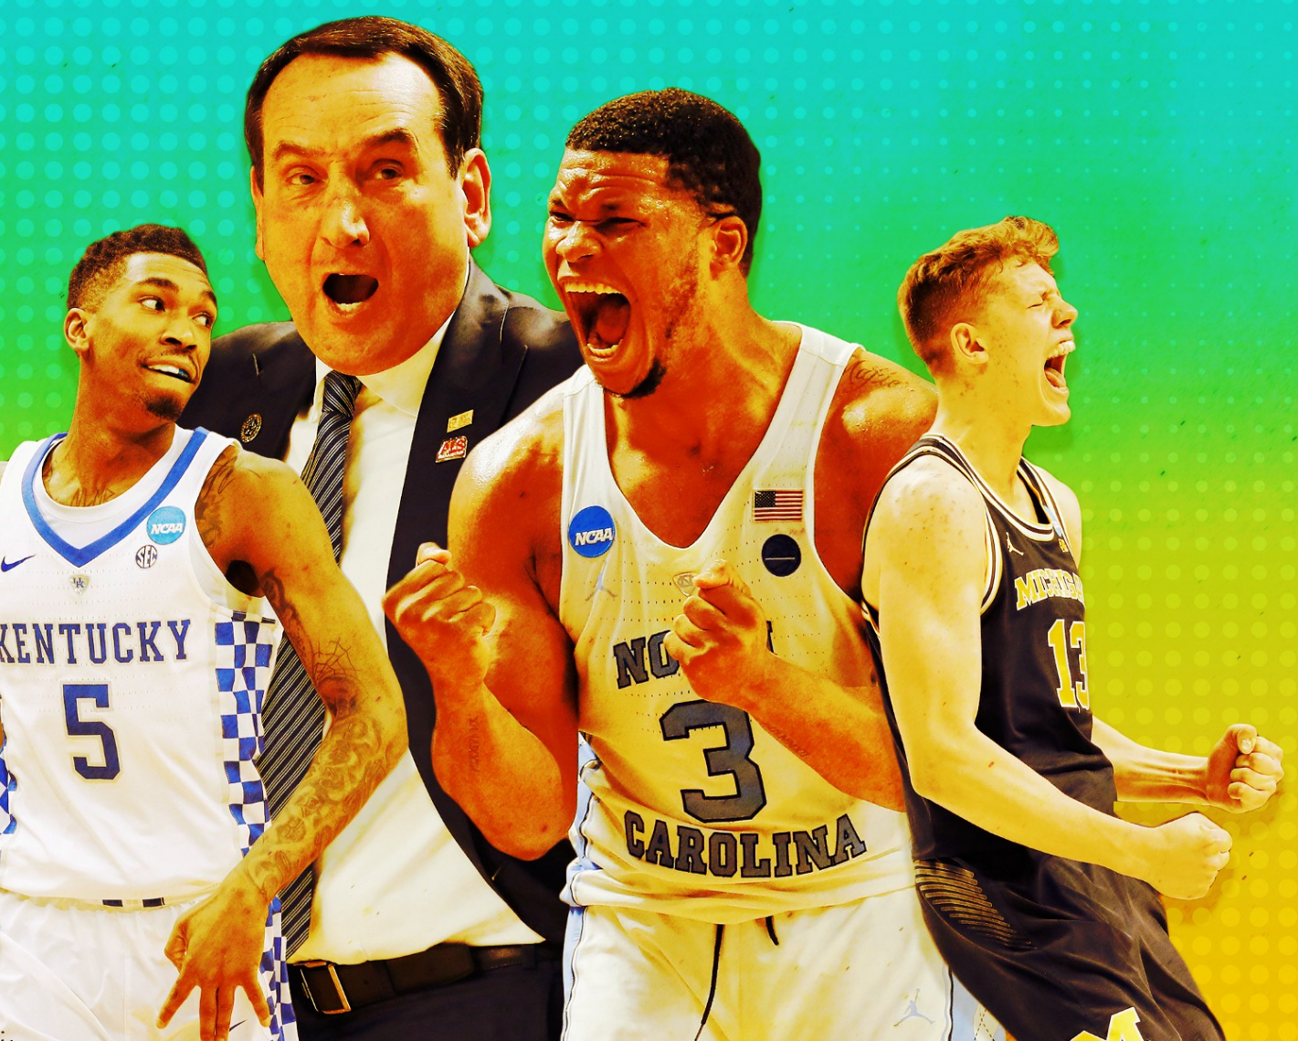
Predicting the ncaa Basketball tournament with Machine Learning Andrew Levandoski and Jonathan Lobo
The Ringer/Getty Images

Slide 2
The tournament

Slide 3
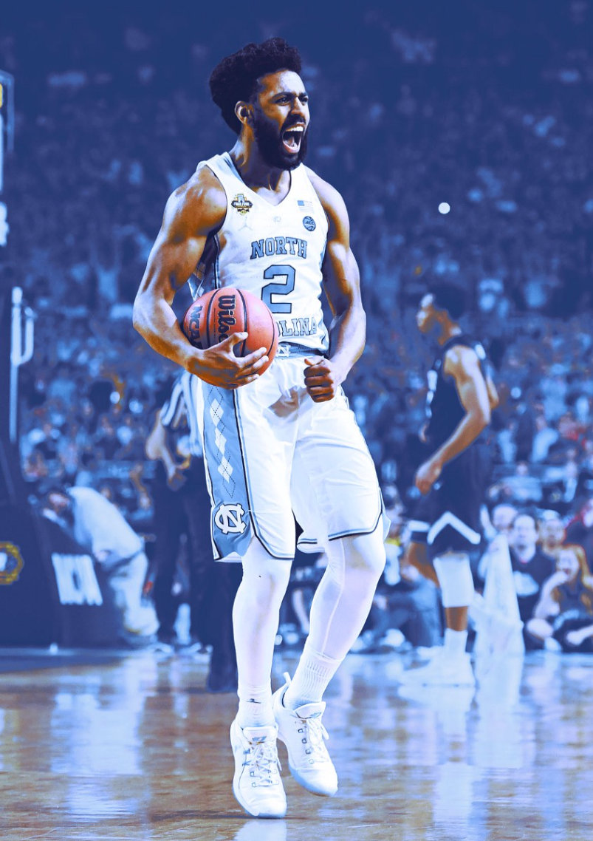
March Madness
68 teams (4 play-in games)
63 single-elimination games
4 regions, 16 teams each
Each team seeded 1-16
2017 Champion: North Carolina (#1 seed in South region)
The Ringer/Getty Images

Slide 4
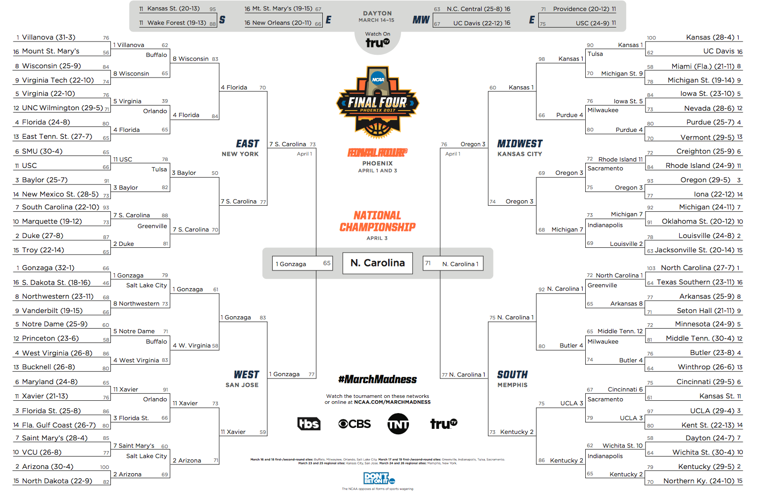
The Bracket
THE BRACKET

Slide 5
bracketology
19 million brackets submitted to ESPN
2⁶³, or 9.2 quintillion, possible brackets
Nobody has ever picked a perfect bracket
$3 billion in bracket pools annually
Warren Buffet offers $1 million for a perfect bracket
/ˌbrakəˈtäləjē/
noun
the activity of predicting the participants in and outcomes of the games in a sports tournament, especially the NCAA college basketball tournament.

Slide 6
Historical Results
Matchup | Higher Seed Win %
1 vs 16 | 100.0%
2 vs 15 | 93.9%
3 vs 14 | 84.1%
4 vs 13 | 80.3%
5 vs 12 | 64.4%
6 vs 11 | 62.9%
7 vs 10 | 61.4%
8 vs 9 | 50.8%

Slide 7
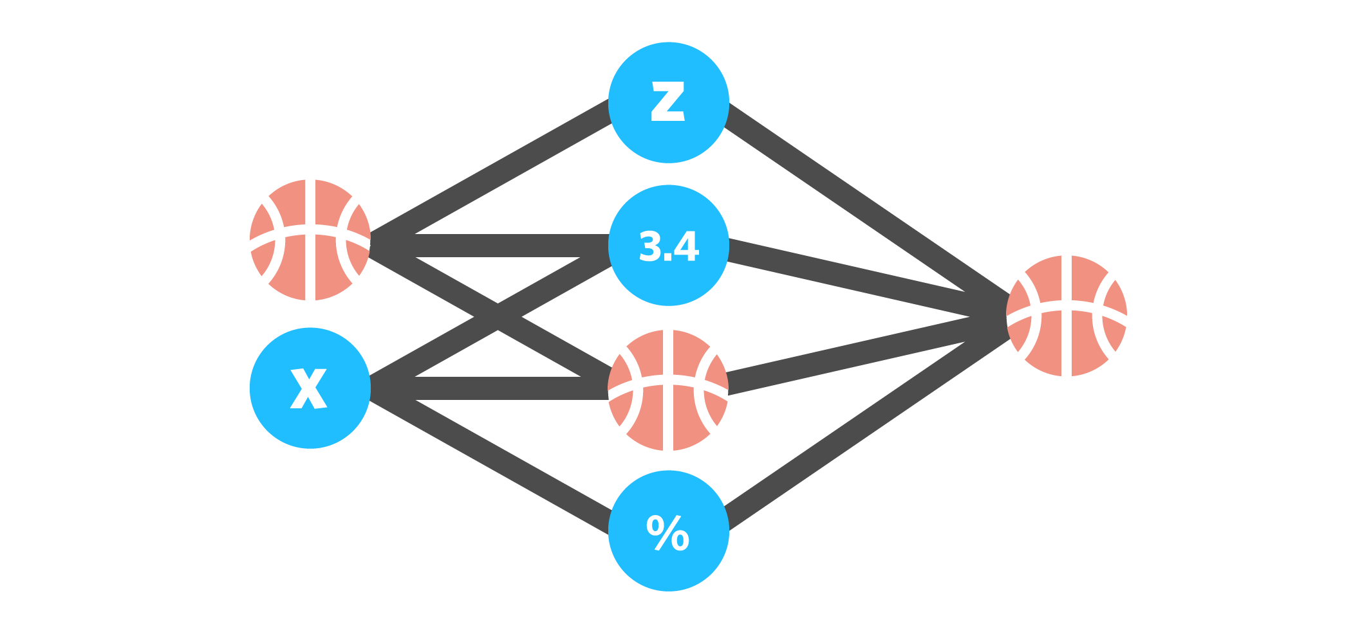
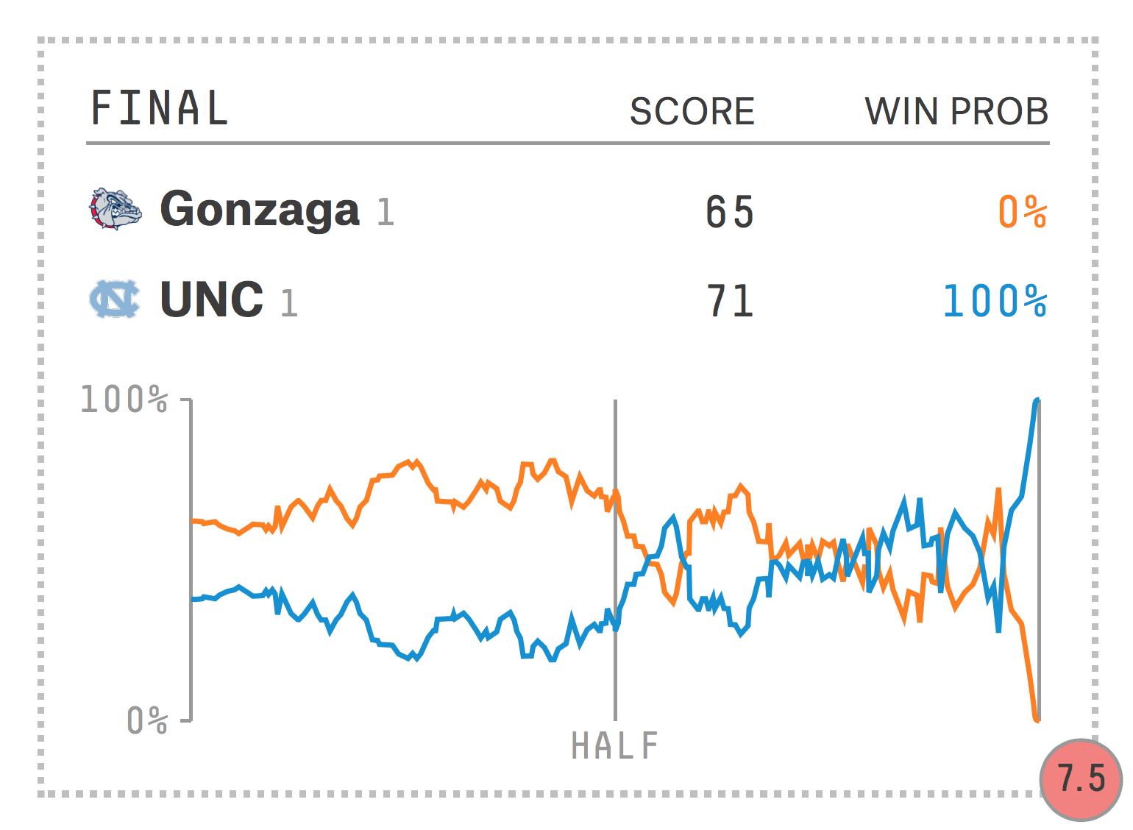
Using ML to build brackets
FiveThirtyEight’s
Prediction Engine
Kaggle’s March Machine Learning Mania 2017

Slide 8
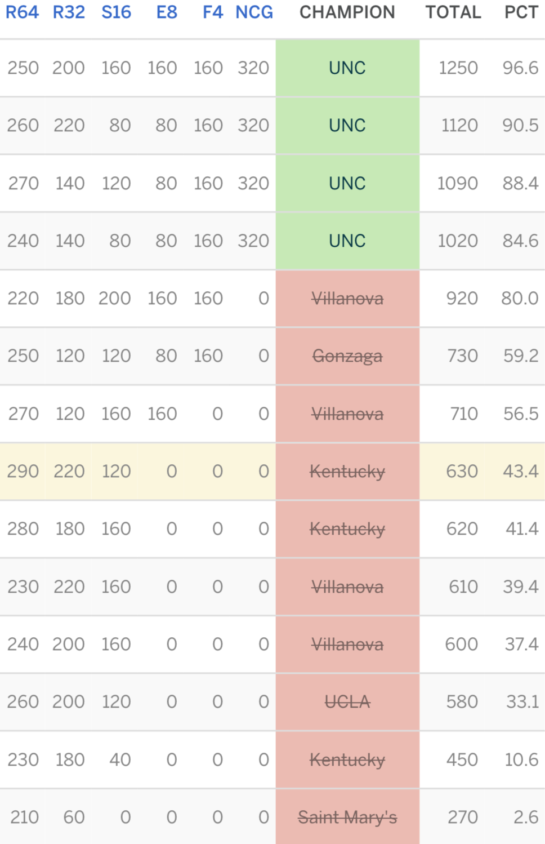
Picking a bracket is really hard!
Jonathan
Andrew ☹

Slide 9
models

Slide 10
How we fix this:
PREVIOUS WORK
Pick only relevant features
Analyze a wide range of ML techniques
Build our own model using random forests
Mostly statistical modeling
Poor choice of features
Seeding
Vegas point spread

Slide 11

The data
Points
Field Goals Made
Field Goals Attempted
3-Pointers Made
3-Pointers Attempted
Free Throws Made
Free Throws Attempted
Offensive Rebounds
Defensive Rebounds
Assists
Turnovers
Steals
Blocks
Personal Fouls
Game Location (Home or Away/Neutral)
The Ringer/Getty Images
Notes:
Kaggle dataset
1985 - present

Slide 12
Constructing Training Data
14 chosen statistics computed based on rolling averages of previous games
For teams and their opponents
Only include data from 15 most recent games
Game Location represented as binary flag
No feature for wins or seed
The Ringer/Getty Images

Slide 13
Learning techniques
Adaptive Boosting
K-Nearest Neighbors
Naïve Bayes
Neural Network
Logistic Regression
Support Vector Machine
Random Forests
Trained for classification (picking a winner and loser for each matchup)
AND
determining the likelihood of each outcome

Slide 14
Random Forests
The combination of learning models increases classification accuracy
Bagging: average noisy and unbiased models to create a model with low variance
The random forest algorithm acts as a large collection of decorrelated decision trees

Slide 15
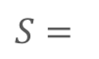
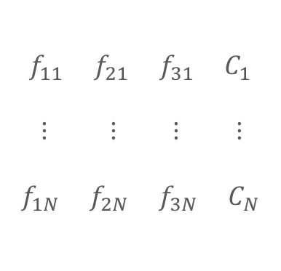
Decision tree
Feature 1 of the 1st sample
$$f_{11}{ f}_{21}{ f}_{31}{ C}_{1}$$
$⋮ ⋮ ⋮ ⋮$
$$f_{1N}{ f}_{2N}{ f}_{3N}{ C}_{N}$$
$S=$
Feature 2 of the N^{th} sample

Slide 16
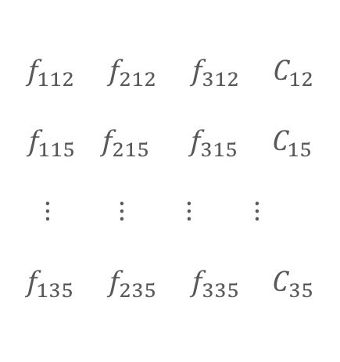
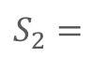
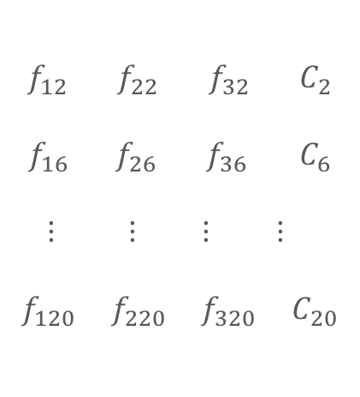
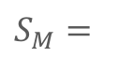
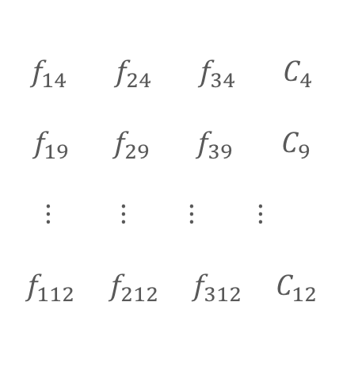
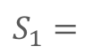
Random subsets
$$f_{112}{ f}_{212}{ f}_{312}{ C}_{12}$$
$$f_{115 }f_{215}{ f}_{315 }C_{15}$$
$⋮ ⋮ ⋮ ⋮$
$$f_{135}{ f}_{235}{ f}_{335}{ C}_{35}$$
$$f_{12}{ f}_{22}{ f}_{32}{ C}_{2}$$
$$f_{16 }f_{26}{ f}_{36 }C_{6}$$
$⋮ ⋮ ⋮ ⋮$
$$f_{120}{ f}_{220}{ f}_{320}{ C}_{20}$$
$S_{1}=$
$S_{2}=$
$$f_{14}{ f}_{24}{ f}_{34}{ C}_{4}$$
$$f_{19 }f_{29}{ f}_{39 }C_{9}$$
$⋮ ⋮ ⋮ ⋮$
$$f_{112}{ f}_{212}{ f}_{312}{ C}_{12}$$
$S_{M}=$

Slide 17
Random subsets
Decision Tree 2
$$f_{112}{ f}_{212}{ f}_{312}{ C}_{12}$$
$$f_{115 }f_{215}{ f}_{315 }C_{15}$$
$⋮ ⋮ ⋮ ⋮$
$$f_{135}{ f}_{235}{ f}_{335}{ C}_{35}$$
$$f_{12}{ f}_{22}{ f}_{32}{ C}_{2}$$
$$f_{16 }f_{26}{ f}_{36 }C_{6}$$
$⋮ ⋮ ⋮ ⋮$
$$f_{120}{ f}_{220}{ f}_{320}{ C}_{20}$$
$S_{1}=$
$S_{2}=$
Decision Tree 1
$$f_{14}{ f}_{24}{ f}_{34}{ C}_{4}$$
$$f_{19 }f_{29}{ f}_{39 }C_{9}$$
$⋮ ⋮ ⋮ ⋮$
$$f_{112}{ f}_{212}{ f}_{312}{ C}_{12}$$
$S_{M}=$
Decision Tree M

Slide 18
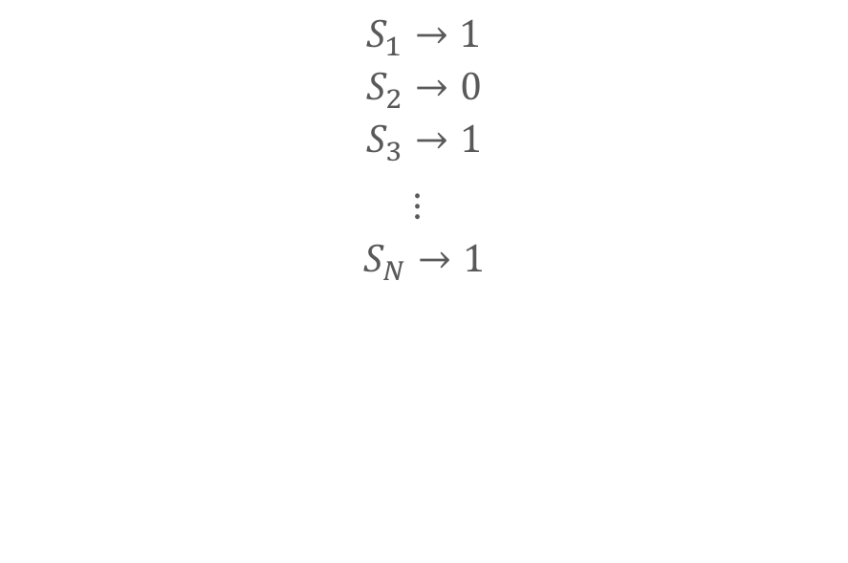
voting
$$S_{1}→1$$
$$S_{2}→0$$
$$S_{3}→1$$
$⋮$
$$S_{N}→1$$
Label as majority vote

Slide 19

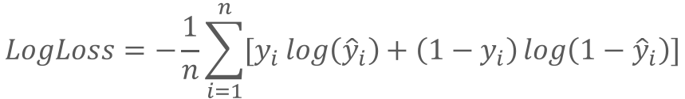
Method Evaluation
Accuracy
Bracket score
Log Loss (for probabilities)
$$LogLoss=−\frac{1}{n}\sum_{i=1}^{n}{[y_{i}\log\left({\hat{y}}_{i}\right)+\left(1−y_{i}\right)\log\left(1−{\hat{y}}_{i}\right)]}$$
where n is the number of games played,
y_{i} is the predicted probability of team 1 beating team 2,
and y_{i} is 1 if team 1 wins, 0 if team 2 wins.
The Ringer/Getty Images

Slide 20
Results

Slide 21
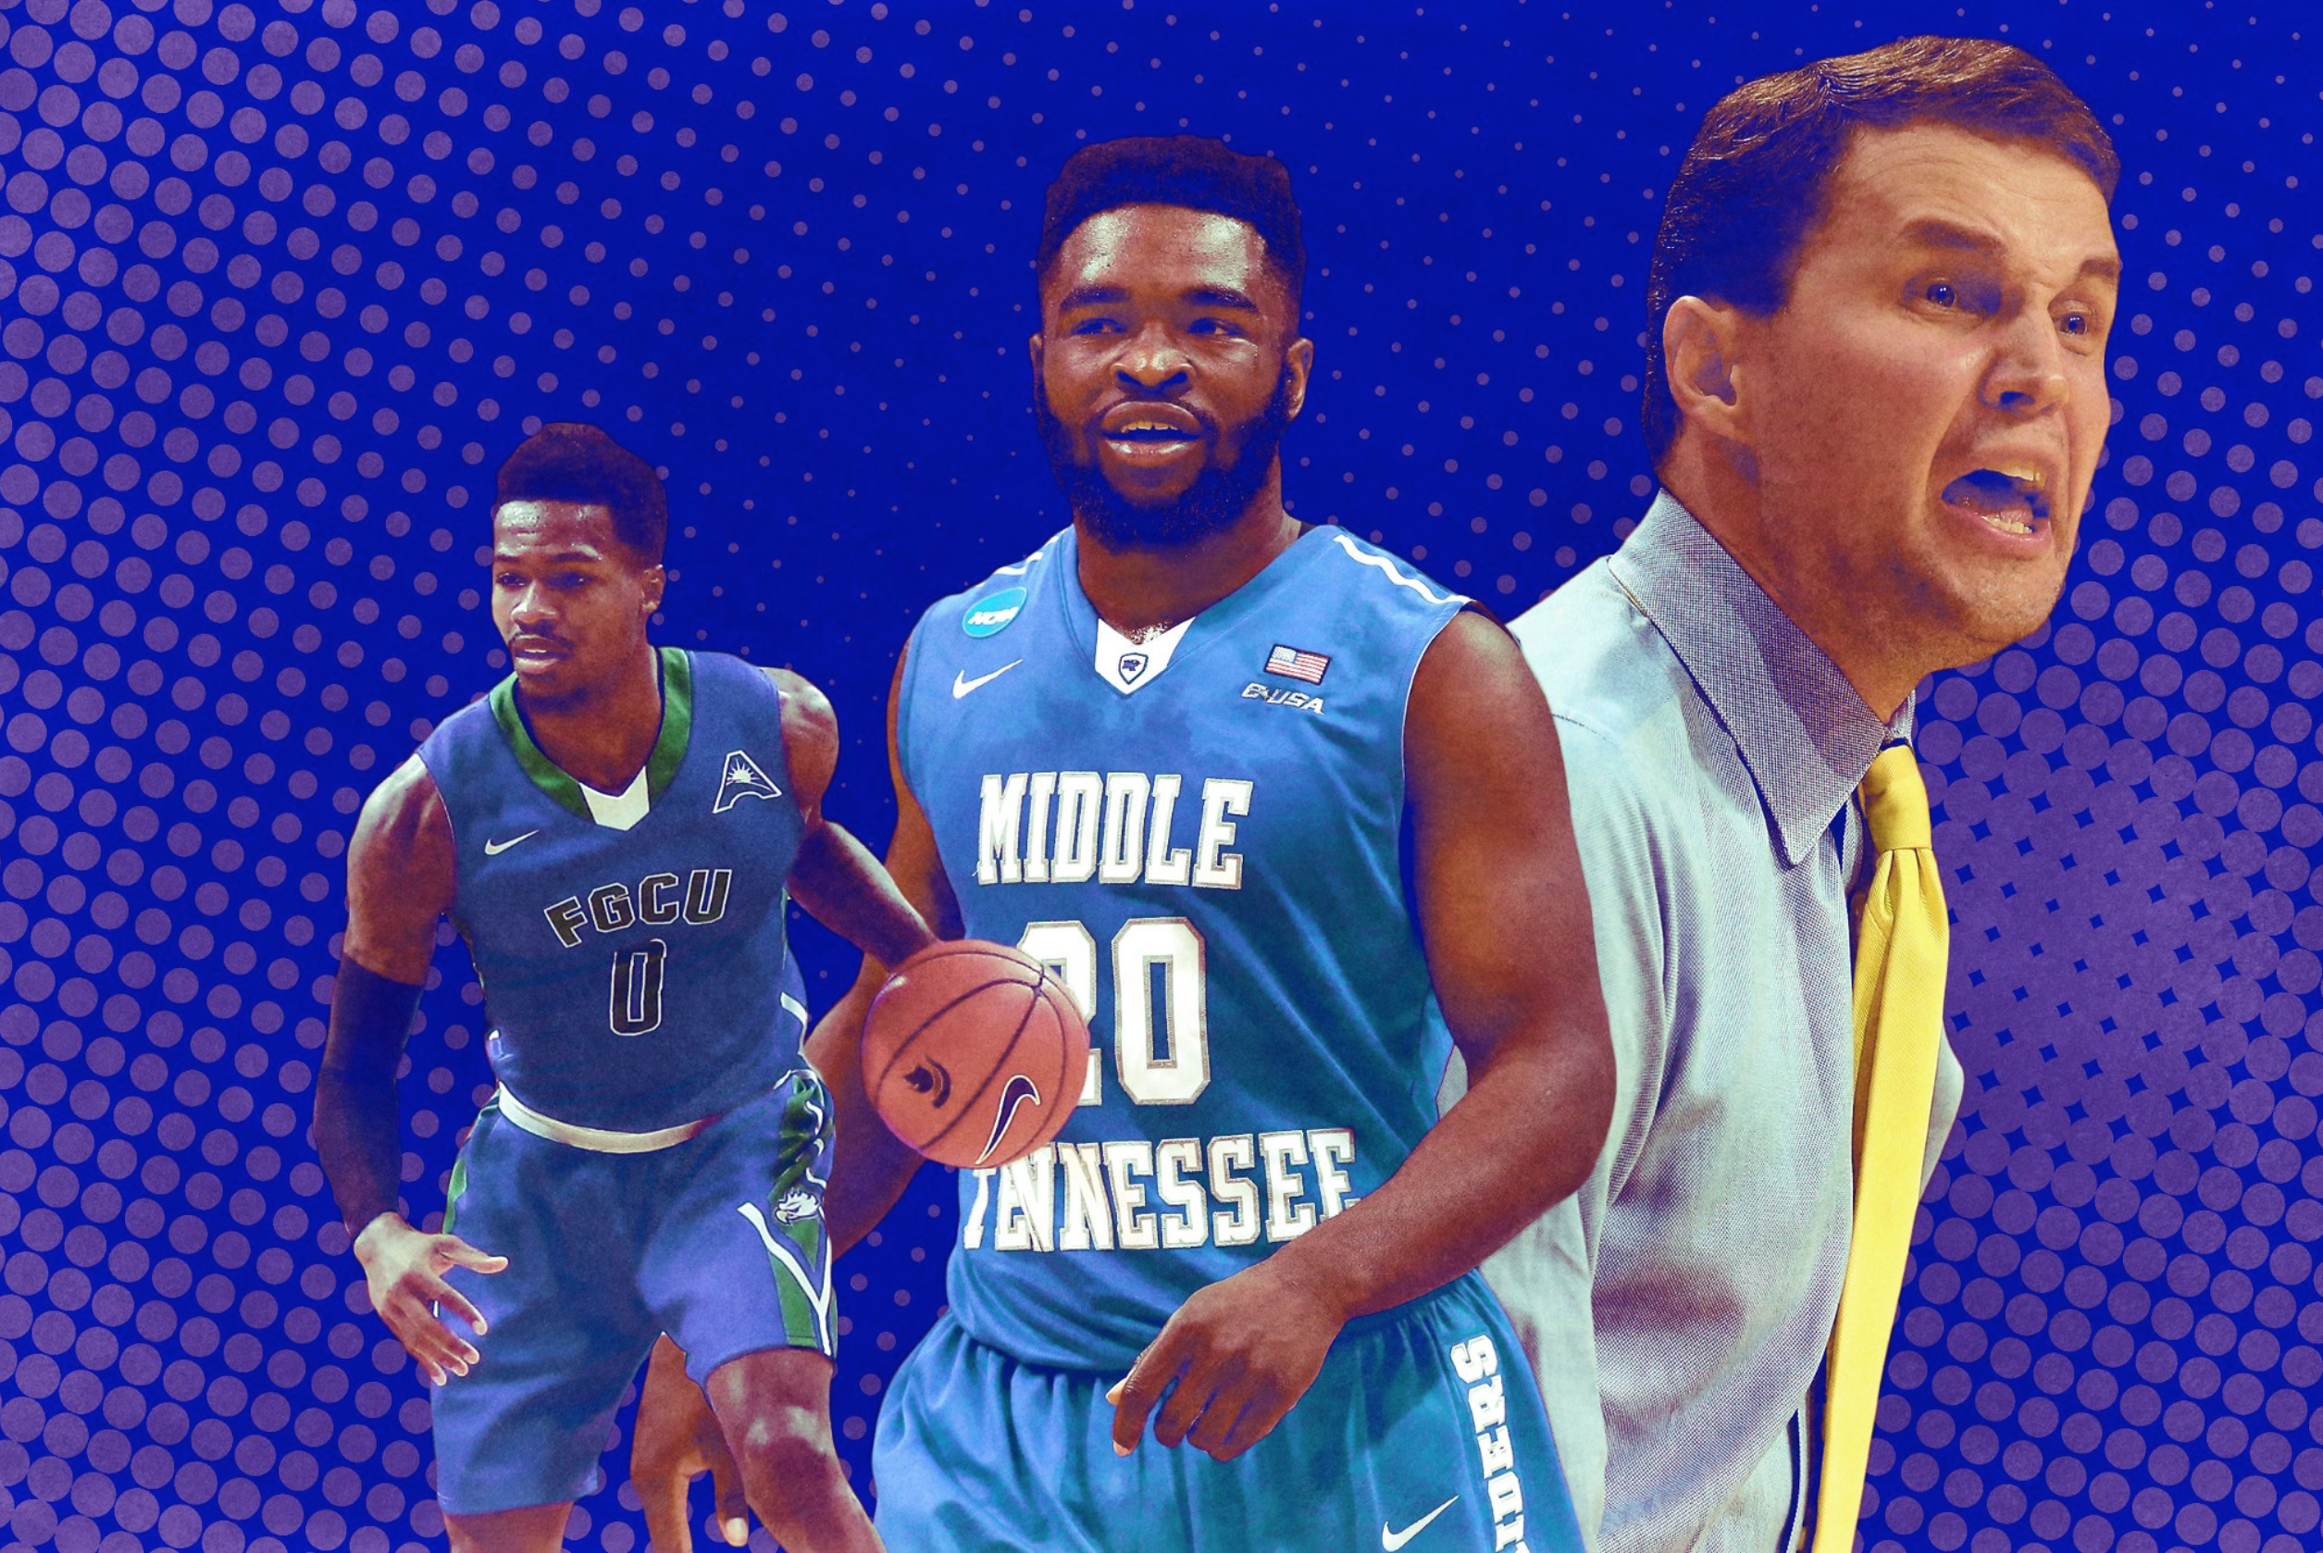
Classification accuracy
Algorithm | Accuracy
KNN | .619
AdaBoost | .667
SVM | .683
Bayes | .698
Random Forests | .698
Regression | .762
Neural Net | .794
The Ringer/Getty Images

Slide 22
Bracket Scores
Algorithm | Score
AdaBoost | 400
SVM | 570
KNN | 600
Bayes | 610
Neural Net | 650
Regression | 670
Random Forests | 900
The Ringer/Getty Images

Slide 23
Log Loss
Algorithm | Score
AdaBoost | 1.261
KNN | .687
SVM | .657
Bayes | .579
Random Forests | .578
Neural Net | .545
Regression | .529
The Ringer/Getty Images

Slide 24
Algorithm | Log Loss | Accuracy | Bracket Score
AdaBoost | 1.261 | .667 | 400
KNN | .687 | .619 | 600
SVM | .657 | .683 | 570
Bayes | .579 | .698 | 610
Random Forests | .578 | .698 | 900
Neural Net | .545 | .794 | 650
Regression | .529 | .762 | 670

Slide 25
references
Image Credits: Getty Images, The Ringer
B.J. Coleman, J.M. DuMond, and A.K. Lynch, “Evidence of Bias in NCAA Tournament Selection and Seeding”,
Managerial and Decision Economics, vol. 31, 2010.
Kaggle.com, March Machine Learning Mania 2017”, “https://www.kaggle.com/c/march-machine-learning-
mania-2017”, 2017.
L.H. Yuan et al, “A mixture-of-modelers approach to forecasting NCAA tournament outcomes”, Journal
of Quantitative Analysis of Sports, vol. 11, 2014.
M.J. Lopez and G.J. Matthews, “Building an NCAA men’s basketball predictive model and quantifying its
success”, Journal of Quantitative Analysis of Sports, vol. 11, 2014.
Z. Shi, S. Moorthy, and A. Zimmermann, “Predicting NCAAB match outcomes using ML techniques - some
results and lessons learned”, ArXiv e-prints, “https://arxiv.org/abs/1310.3607”, 2013.

